Slide 1


Unit 2
HHFA questionnaire structure
Notes:
Welcome to Unit 2 of Module 2.

Slide 2
By the end of this unit, you will be able to:
state the number of columns into which the questionnaire is divided
describe the kind of information you can find in
each column
Notes:
By the end of this unit, you will be able to:
state the number of columns into which the questionnaire is divided;
describe the kind of information you can find in each column.

Slide 3
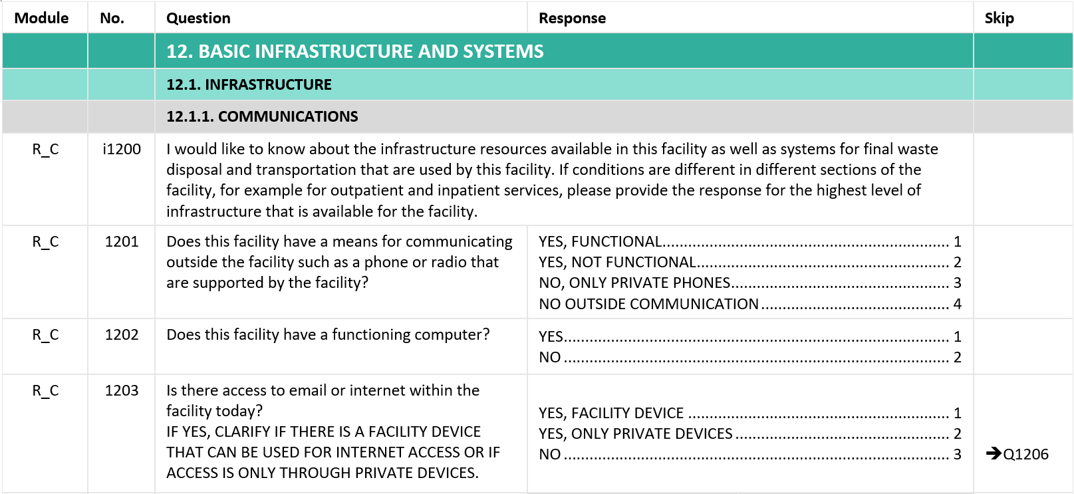
Questionnaire structure
1. Module
2. No.
3. Question
4. Response
5. Skip
Notes:
In this unit, we will look at the structure of the HHFA paper questionnaire. ​
​
The questionnaire is typically divided into 5 columns:​
​
the first column is Module;
the second column, No. is the abbreviation of Number;​
the third column is Question;​
the fourth column is Response; and ​
the fifth column is Skip.​
​
Please note, the visual guide shown here is based on the paper questionnaire. All data entry is conducted in the CSPro tool.​

Slide 4
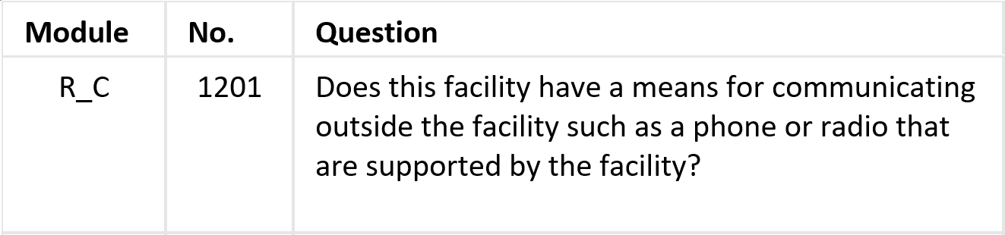
Column 1: Module
Module
Type of question (Core or Additional)
Notes:
Let’s start by looking at column 1, “module”. This column contains two letters separated by an underscore.
The first letter shows the module to which the question belongs. This may be:
A for Availability;
R for Readiness; or
M for Management and finance.
The second letter represents the type of question:
C for core; or
A for additional.
So in this example, the first column is telling us that the question is a core question that belongs to the ¨Readiness¨ module.

Slide 5
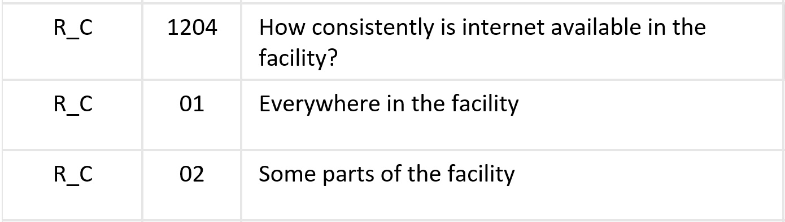
Column 2: No. (Number)
Main question number: 1204
Notes:
Column 2, “number” indicates the number of the question that we are going to ask the respondent. ​
Some numbers found in this column have the letter “i” before the number.
In this case, the number refers to:
information we are going to give to the respondent; or
a set of instructions for the interviewer.
In this example, number 1204 corresponds to the question “How consistently is internet available in the facility?”.

Slide 6
Column 2: No. (Number)
Sub-question numbers
Notes:
Sub-questions within the main question are listed immediately below the main question, starting with the number 01.
In this example,
sub-question 1204_01 is asking whether internet is available everywhere in the facility; and
sub-question 1204_02 is asking whether internet is available in some parts of the facility.

Slide 7
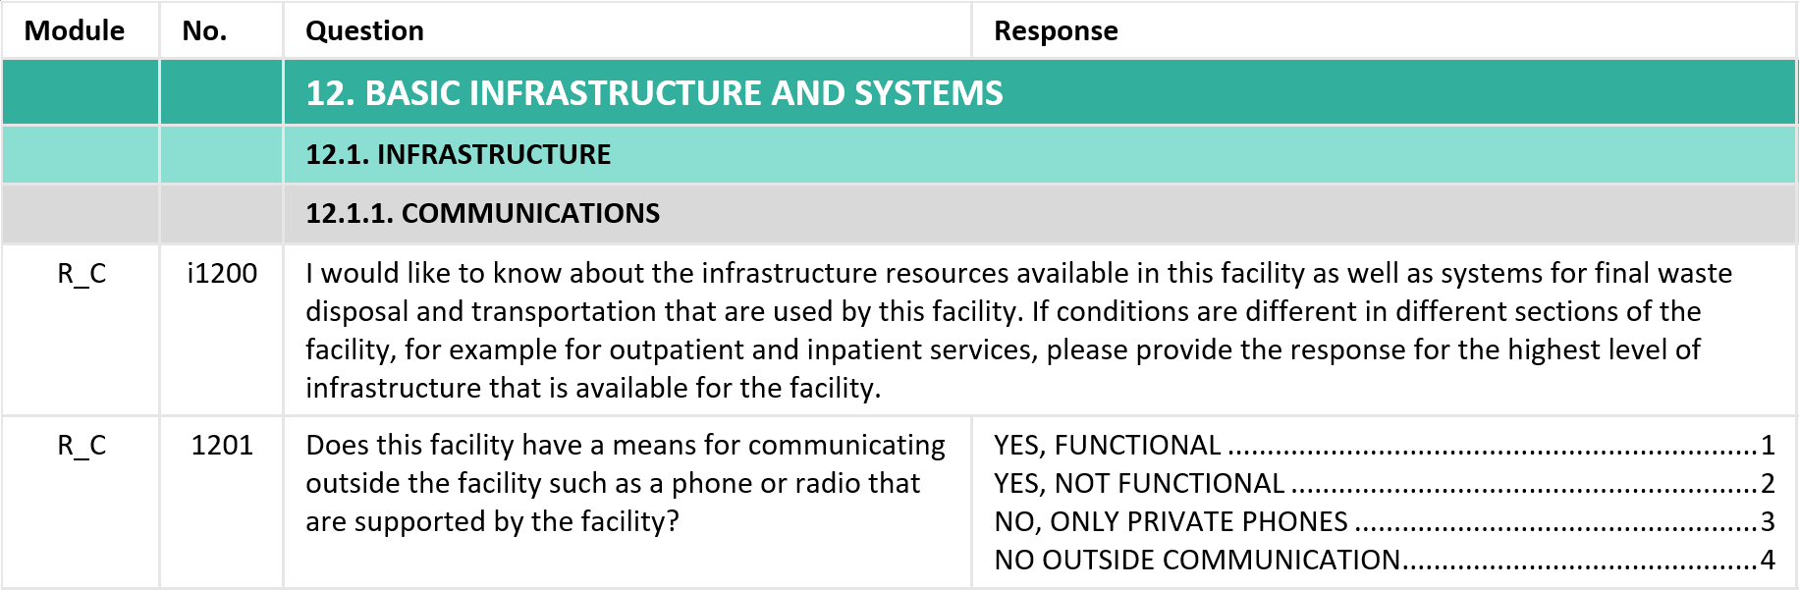
Column 3: Question
These sentences must be read to the respondent,
so that they know what to expect from the next set of questions.
Notes:
Column 3 is called Question. It contains the text of the question to be read to the respondent. In addition to questions that will be asked to the respondents, this column also contains information for the respondent, in lower case font, and often in a format that extends across column 4.
For example, question 1200 shows how some questions start with an introductory paragraph for data collectors to use to inform respondents about the information that is going to be collected.
These sentences must be read to the respondent, so that they know what to expect from the next set of questions.

Slide 8
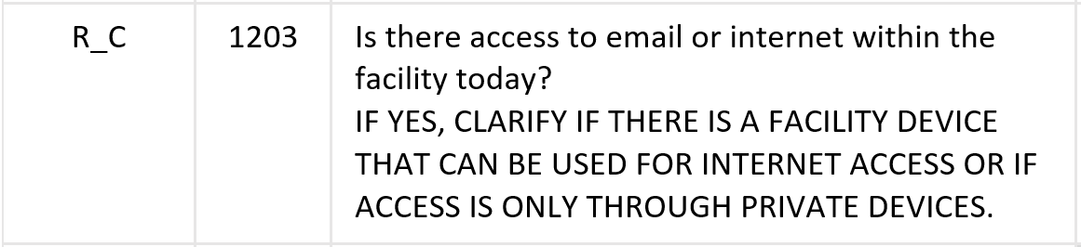
Column 3: Question
instructions for the data collector appear in CAPITAL LETTERS
they help data collectors to complete the questionnaire as accurately and completely as possible
Notes:
Questions are sometimes accompanied by a set of instructions for the data collector. These instructions are always provided in capital letters.
The instructions will help the data collector to complete the questionnaire as accurately and completely as possible, by:
asking questions in the right way;
making correct observations; and
recording information properly.
These instructions should not be read to respondents.

Slide 9
Column 3: Question
instructions for the data collector appear in CAPITAL LETTERS
they help data collectors to complete the questionnaire as accurately and completely as possible
Notes:
In this example, if the respondent answers yes to question number 1203:
“Is there access to email or internet within the facility today?”
the data collector is instructed to find out whether access is through a facility device or through private devices.

Slide 10
Column 4: Response (ONE option)
for most of the questionnaire, all the possible responses will be coded
there is only one response option to this question, either YES or NO
the data collector selects the correct code, based on the respondent’s answer
Notes:
Column 4, Response, shows the response options for a question or set of questions.
For most of the questionnaire, all the possible responses will be coded. ​
Coding means that a selection of possible responses is provided, and each response is given a number or “code”. So the data collector simply selects the code corresponding to the correct answer.
For example, where question number 1202 asks:
“Does this facility have a functioning computer”?
there is only one response option to this question, either YES or NO. The data should collector should select the correct code, based on the respondent’s answer.

Slide 11
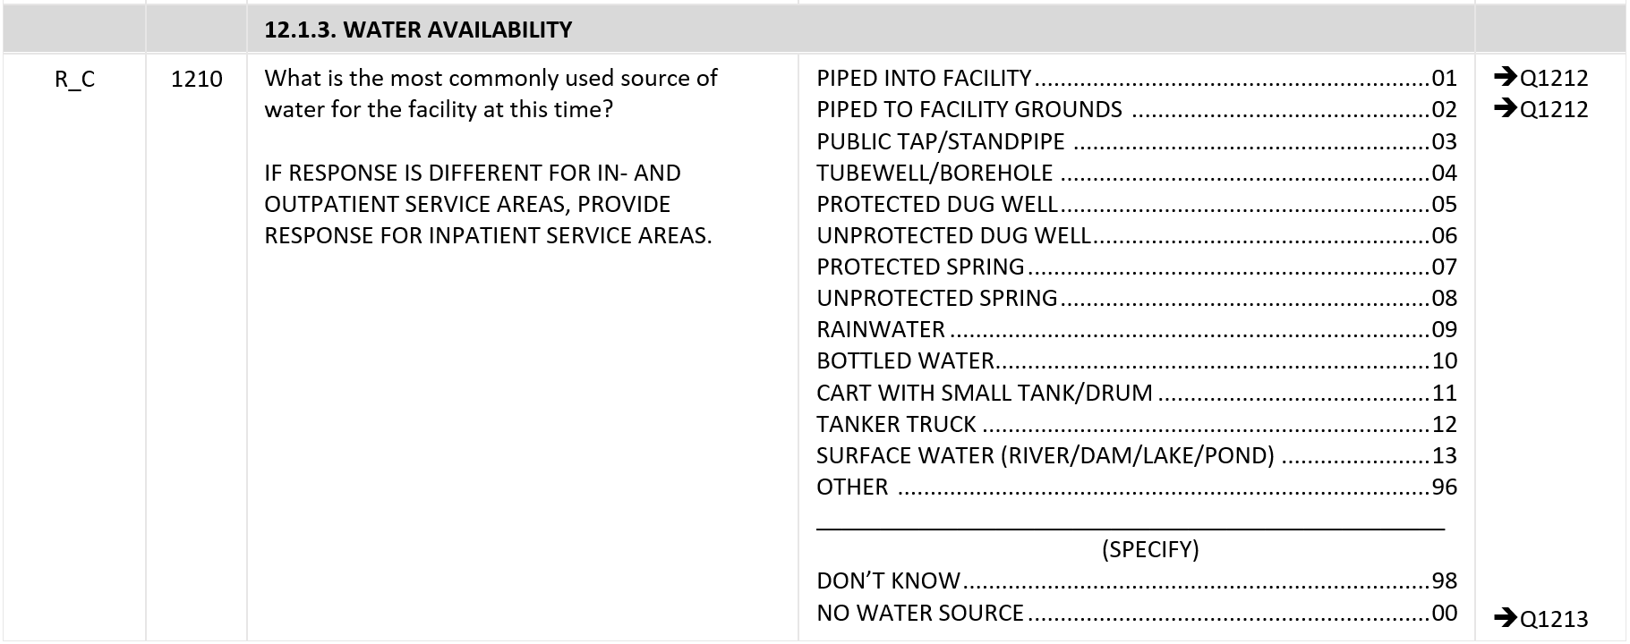
Column 4: Response (ONE option)
select OTHER and write down the specific response
Notes:
However, for some questions we cannot predict all the types of responses a respondent will give. Therefore, we may need to introduce an “other” option to capture non-standard responses.
For example, the question “What is the most commonly used source of water for the facility at this time?” requires only one answer.
However, if the source of water is not in the list, we will need to select OTHER and write the specific response.

Slide 12
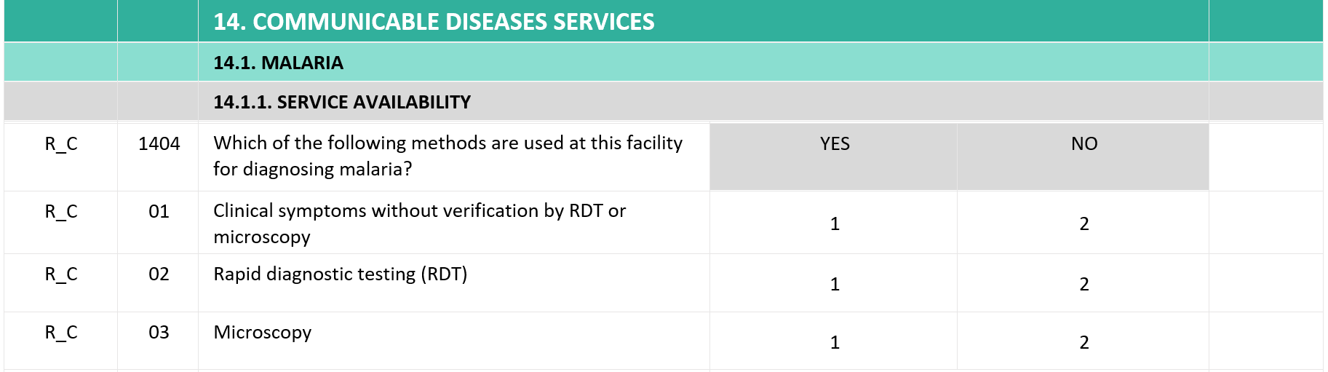
Column 4: Response (SEVERAL options)
for questions with SEVERAL response options, responses must be displayed in a table
Notes:
But what happens if we have questions with many response options?
Let’s look at an example question from Section 14 on Communicable diseases services.
Question 1404 asks about the method(s) the facility uses for diagnosing malaria. As the facility may use more than one method – such as both rapid diagnostic testing and microscopy – we need to provide the option for capturing multiple responses.
When we may need to collect more than one response to a question, the paper questionnaire uses a table instead of a list of options. In the table we have:
The possible methods as rows; and,
The response option Yes or No as columns.

Slide 13
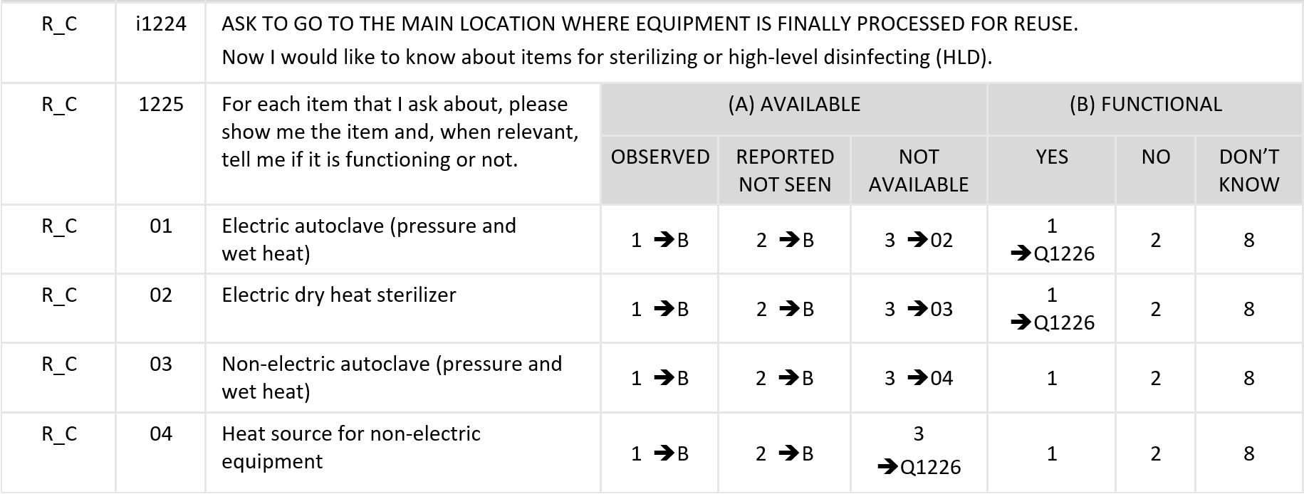
Column 4: Response (SEVERAL options + OBS)
Notes:
Sometimes we need to do more than just record what the respondent says; we need to do some observation.
For example, in the HHFA, we often look at:
the availability of equipment in the service area; and
whether the equipment is functioning.
It is common that to provide quality services the site needs different types of equipment.
To address this, the questionnaire provides a response table that contains:
As rows, the different types of equipment; and
As columns, the response options to observe the equipment and record whether it works.
For example, for question 1225, we want to know whether equipment for sterilizing or high-level disinfection is available and if it is functioning.
From this example, we can see that column 4 captures two key types of information: “availability” and “functionality”.

Slide 14
Column 4: Response (SEVERAL options + OBS)
Availability of items
Whether it is equipment for sterilizing, or any other equipment, commodities, or documents, the following criteria should be used for recording this type of information:
“1” for “OBSERVED”
“2” for “REPORTED, NOT SEEN”
“3” for “NOT AVAILABLE”
Notes:
Let’s start by looking at how to record information about the availability of items. ​
Whether it is equipment for sterilizing, or any other equipment, commodities, or documents, the following criteria should be used for recording this type of information:​​
"1" for "OBSERVED": Select “1” when you have seen the item in the service site or in a nearby room where it can easily be accessed for use. ​ ​
"2" for "REPORTED, NOT SEEN": Select “2” any time the respondent reports the item is available in the service site or in a nearby room where it can easily be accessed when needed for use, but for some reason the data collector cannot observe the item. For example, the key to the cabinet is missing or the room is locked.​​
“3” for “NOT AVAILABLE”: Select “3” when the respondent reports that the item is not available in the service site or in a nearby room where it can easily be accessed when needed.

Slide 15
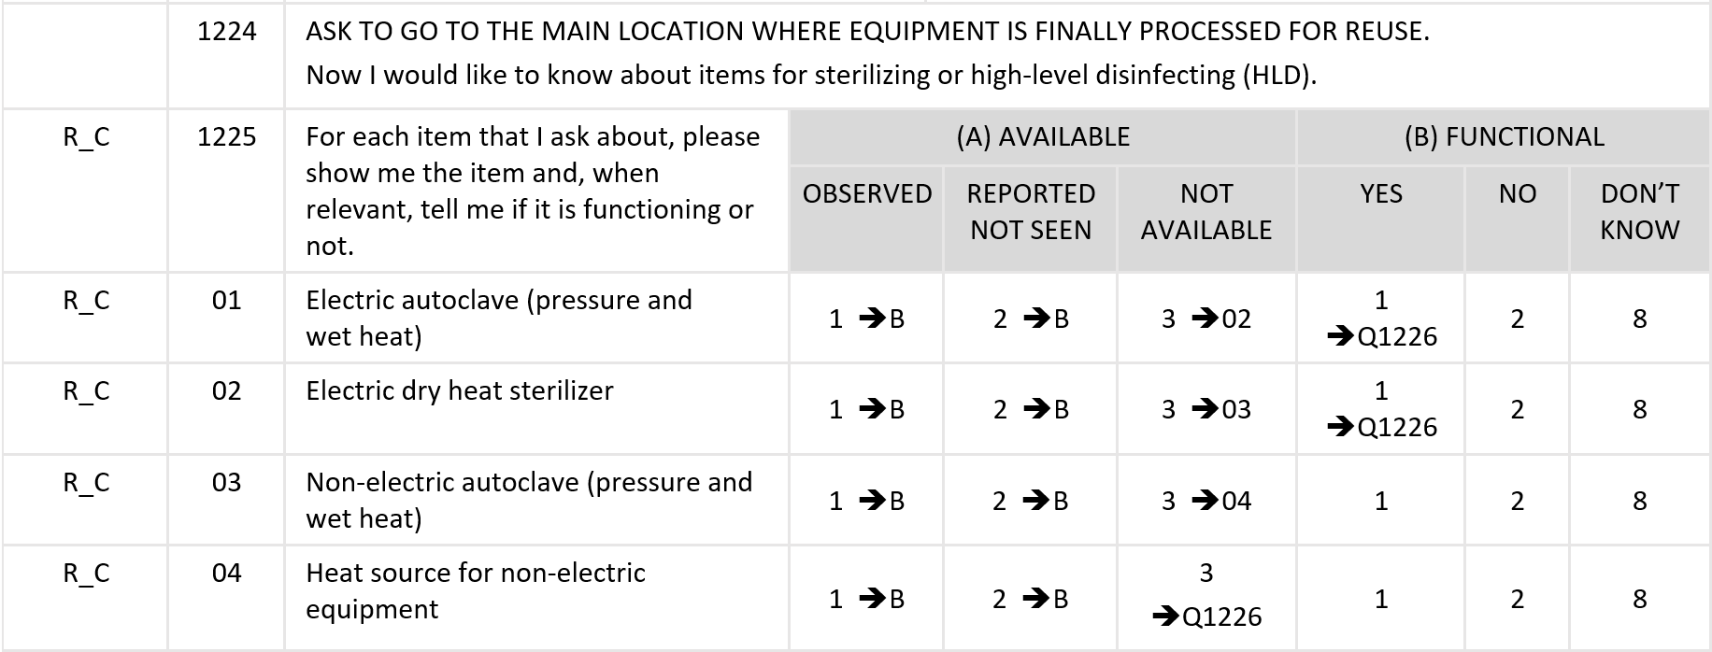
Column 4: Response (SEVERAL options + OBS)
Notes:
So for the question about sterilizing equipment, we will:
ask to go to the main location where equipment is finally processed for reuse;
say to the respondent:
“Now I would like to know about items for sterilizing or high-level disinfecting. For each item that I ask about, please show me the item and, when relevant, tell me if it is functioning or not”;
start with the electric autoclave;
if we see it, we select 1, which then takes us to column B on functionality;
if the respondent tells us that it is available in the service site or in a nearby room where it can easily be accessed when needed for use, but for any reason whatsoever, we cannot see it, then we select 2, which also takes us to column B on functionality;
if the respondent tells us that it is not available, we must select 3, which takes us to row 02, without any need to ask about functionality as the autoclave is not available.

Slide 16
Column 4: Response (SEVERAL options + OBS)
Functionality
For some “OBSERVED” or “REPORTED, NOT SEEN” items, the data collector needs to determine if the item is functioning at the time of the visit.
The following criteria should be used for recording the information:
“1” for “YES”
“2” for “NO”
“8” for “DON’T KNOW”
Notes:
Next, we’ll look at how to record information on functionality.​
For some “OBSERVED” or “REPORTED, NOT SEEN” equipment and diagnostics, we need to determine if the item is functioning at the time of our visit. ​
For recording information in functionality, we use the following criteria:​
“1” for “YES”: We observe that the item is in working order or, if it is in a location where it is not reasonable to ask to see if the equipment is functioning (e.g. a generator), the respondent indicates that it is functional.​
“2” for “NO”: The item is not functional if the respondent indicates that it is not in working order. ​
“8” for “DON’T KNOW”: The respondent is not certain if the item is in working order or not, and the data collector cannot verify the functioning condition. For example, the place where the item is kept might be locked and the respondent does not know about status of the item.​

Slide 17
Column 4: Response (SEVERAL options + OBS)
Notes:
Imagine that in our example about sterilizing or high-level disinfecting equipment, we were either able to observe the electric autoclave, or the respondent told us it is available, but we couldn’t observe it. ​
We then need to go to column B on functioning and verify that the item is working or ask the respondent whether it works, in case it is not easily verifiable.
if it does work, then we select 1 and go to question 1226;
if it doesn’t work, then we select 2 and go to the next row 02; and
if the respondent is not sure and we cannot verify that it is working, then we check 8 and go to row 02.
It is important that we follow the sequence in the questionnaire as guided by the arrows.
We may not need to ask about all the items. As seen in this example, if the facility has a working electric autoclave, we may jump directly to another question.

Slide 18
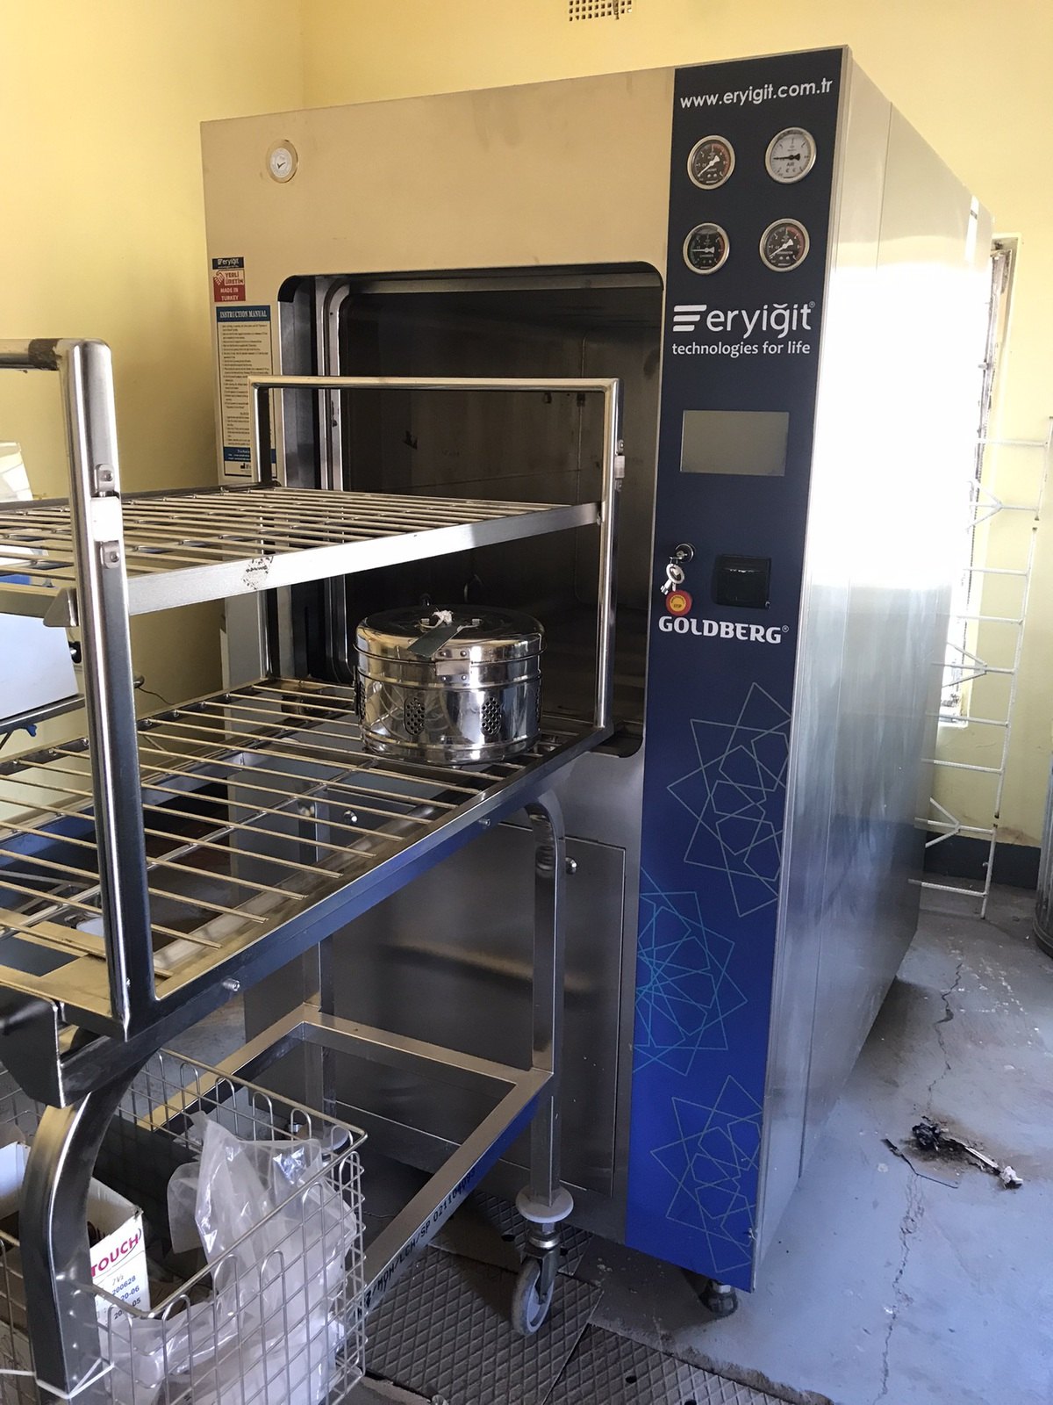
Column 4: Response (SEVERAL options + OBS)
© WHO / Yolanda Barbera
Notes:
So imagine you are at the main location in the facility where equipment is finally processed for reuse.
When asking the respondent whether there is an electric autoclave, the respondent shows you this piece of equipment and also tells you it is functioning today.

Slide 19
Column 4: Response (SEVERAL options + OBS)
Notes:
In this case, you would:
Go to column (A) AVAILABLE and select 1 under OBSERVED;
then go to column (B) FUNCTIONAL and select 1 under YES.

Slide 20
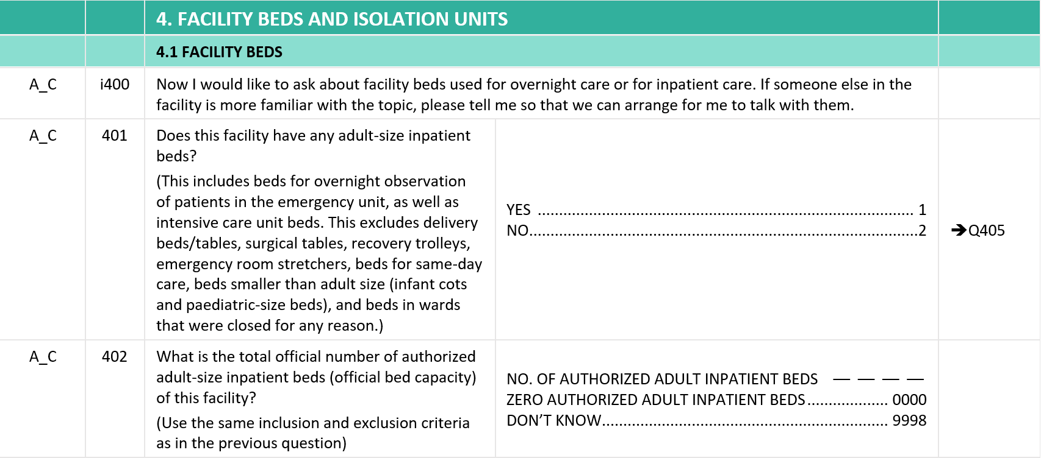
Column 4: Response (numeric)
0 0 3 2
Notes:
Some HHFA questions require a numeric response, which should be recorded in the appropriate available boxes.
​
In this example from Section 4, question 402 asks for the official number of authorized adult-size inpatient beds.
If there are 32 beds; we will record this number in the questionnaire.
If there are no inpatient beds in the facility, we will select the 0000 option.

Slide 21
Column 5: Skip
questionnaire is set up to ask only appropriate questions for a given situation
this is possible because of skip patterns, which:
“skip over” questions that are not applicable, based on the answer to a previous question
make the questionnaire more concise and relevant
increase the cooperation of the respondent
electronic (CSPro) questionnaires have the skip patterns built into the configuration, so the data collector doesn’t see them
Notes:
Now let’s look at column 5, which provides the instructions to skip to another question or to some information.
The questionnaire is set up to ask only appropriate questions for a given situation. This is possible because of skip patterns, which:
“skip over” questions that are not applicable, based on the answer to a previous question; and so​
make the questionnaire more concise and relevant; and​
help to increase the cooperation of the respondent.
Note that the electronic (CSPro) questionnaires have the skip patterns built into the configuration, so that skips happen automatically and the data collector doesn’t see them.

Slide 22
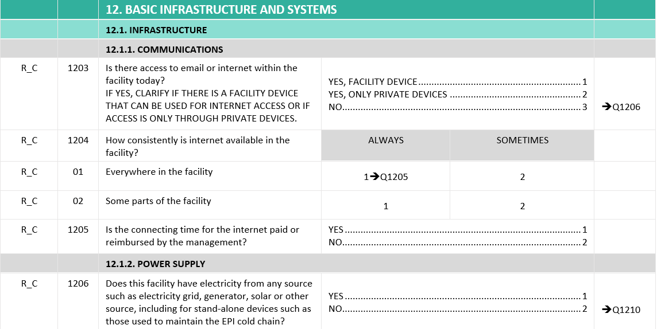
Column 5: Skip patterns
Notes:
For example, question number 1203 asks:
“Is there access to email or internet within the facility today?”
If the respondent says NO, the data collector does not need to ask:
question 1204 about consistency of the access; or
question 1205 about whether costs are covered by facility management.
The data collector can directly jump to the POWER SUPPLY section and continue with question 1206 about electricity.
However, if the answer were “YES”, the data collector would continue to the next question, in this case question 1204.

Slide 23
Summary
the first column shows the module and the type of question
the second column shows the question or sub-question number
the third column shows the questions and the information provided to the respondent, as well as the instructions to the data collector
the fourth column shows the responses
the fifth column shows when and how to skip questions
Notes:
To summarize, the paper questionnaire is divided into five columns:
the first column shows the module and the type of question;
the second column shows the question or sub-question number;
the third column shows the questions and the information provided to the respondent, as well as the instructions to the data collector;
the fourth column shows the responses; and
the fifth column shows when and how to skip questions.

Slide 24
You have now completed Unit 2.
Now try the practice exercise and the end of module quiz.
Notes:
You have now completed Unit 2.
Now try the practice exercise and the end of module quiz.

